Slide 1
Log Ingestor and Query Interface

Slide 2
Things Done
Enabled log ingestion from port 3000, for sample use i have redirected the log data from logIngestion.json as mentioned in project
Created a sample login, ideally it meant for client and admin login, authentications are created but for simplicity use any username and password to redirect to the UI.(role based)
Enabled a single search query which can filter from any column, if it is nested also.
One can specify using drop down, which column should search also
UI offers exclusive searches like full word search, half word search.
Used regular expressions

Slide 3
working
Have client.js, server.js, client.js in one directory
npm install
npm start
This will start the server, and you should see a message indicating that it's listening on http://localhost:3000.
Access the Log Query Interface: Open your web browser and navigate to http://localhost:3000. This will take you to the log query interface.
Log In: Use the provided login form to log in. The default authentication logic assumes any username and password combination is valid for simplicity.
Or use the html page to open in the browser

Slide 4
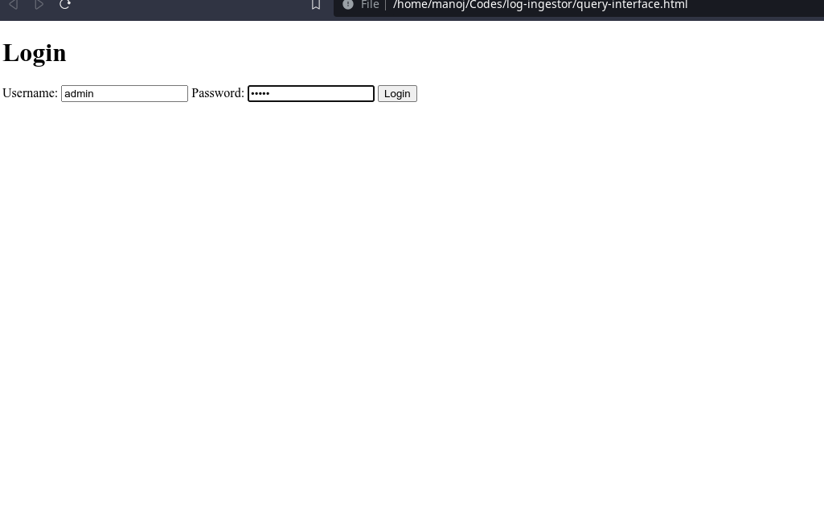
Interface and walkthrough
E
Enter any username and password
E
ddEnter E

Slide 5
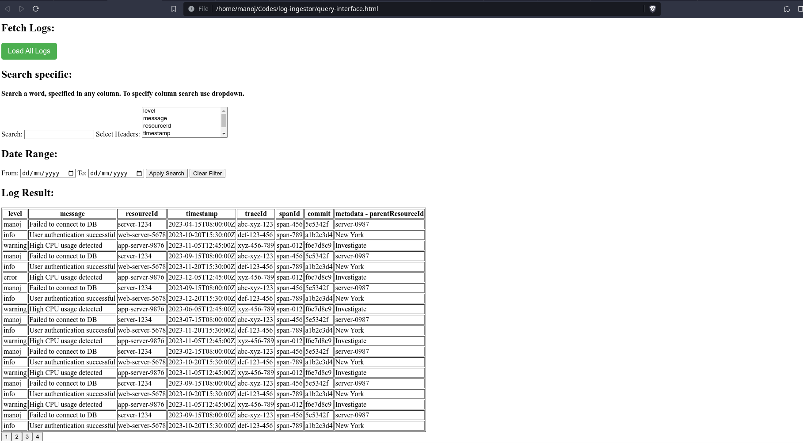

Slide 6
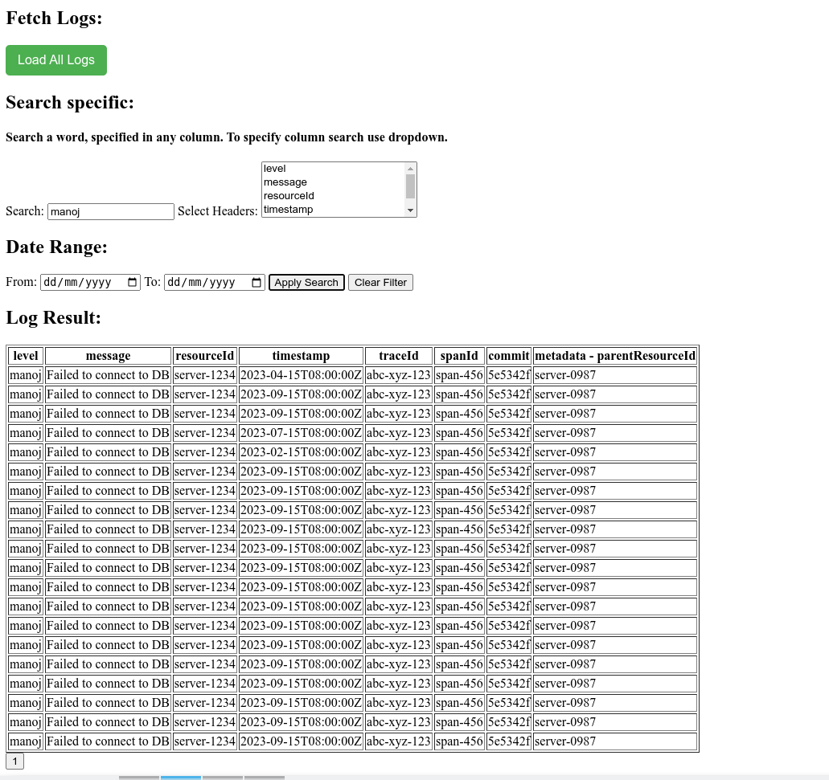
Search based

